Slide 1
Module 1: Microservices

Slide 2
Agenda
Why Cloud Apps?
Handling Failure
Regions, availability zones & fault domains
Distributed Cloud Apps - Microservices
Reasons to split monolithic app to microservices
Auto Scaling
12-factor services
CI/CD
API Versioning

Slide 3
Why Cloud Apps?
Feature | Past | Present
Clients | Enterprise/Internet | Public/Internet
Demands | Stable (small) | Dynamic (small > massive)
Datacenter | Single tenant | Multi tenant
Operations | People | Automation
Scale | via few reliable PCs | via many small PCs
Failure | Unlikely but possible | Very likely
Machine loss | Catastrophic | Normal (no big deal)
Notes:
Clients - Small scale of users thousands, now it’s wide world
Datacenter – running on cloud competing for resources, “noisy neighbor”
Failure – The more resilient the more expensive

Slide 4
Things Must Be Done Differently
Example | Past | Present
Exceptions | Catch, swallow & keep running | Crash & Restart
Communications | In order exactly | Out of order, Clients must retry & server must be idempotent
Notes:
Used to catch exceptions because otherwise the application will crash.
Services running after unhandled exception could be using a corrupted data.

Slide 5
Handling Failures
Some reasons why service instance may fail:
Developer: unhandled exception
DevOps: Scaling the number of services instances down
DevOps: Update service code to new version
Orchestrator: Moving service code to different machine
Force majeure: Hardware failure
Force majeure: Data center outages
Notes:
Used to catch exceptions because otherwise the application will crash.
Services running after unhandled exception could be using a corrupted data.
Cadel vs pets avoid single point of failure
for

Slide 6
Handling Failure
Since failure is inevitable & unavoidable, embrace it
Architect assuming failures will happen; thinks cattle, not pets
Use orchestrator that avoids single points of failure
Run multiple instances of services, replicate data, etc.

Slide 7
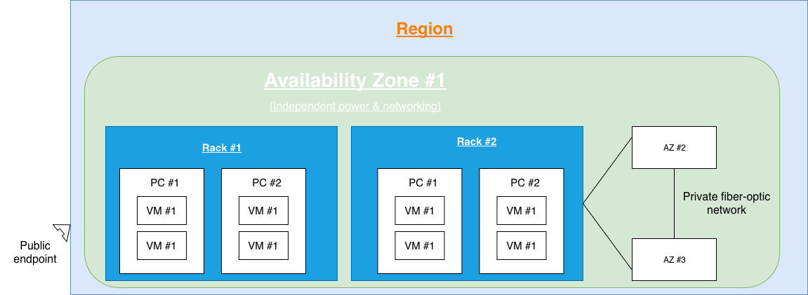

Regions, availability zones & fault domain
A fault domain is a unit of failure
Hierarchy: Planet/Region/Availability Zone/Rack/PC/VM
Intra-service communication: More fault tolerance = higher latency

Slide 8
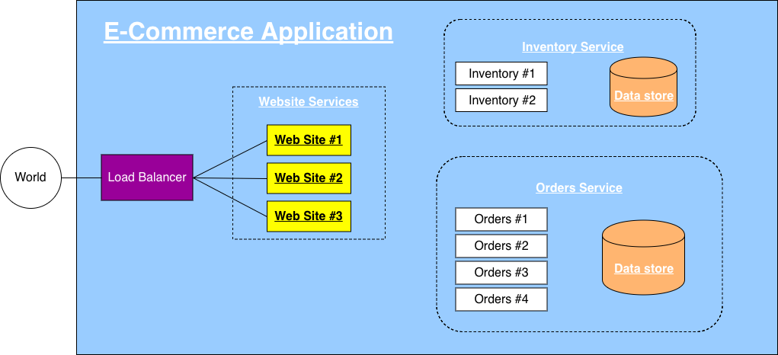
Distributed Cloud Apps - Microservices
Notes:
Microservice. – has his own datastore and only it has access to it, so no other service will brake the schema

Slide 9


Reasons to split monolithic app to microservices
Scale Independently (Balance cost with speed)
Different Technology Stacks

Slide 10
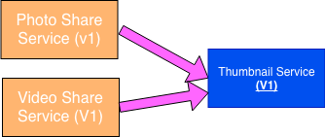
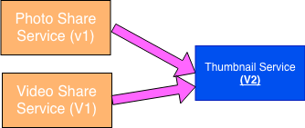
Reasons to split monolithic app to microservices
2+ Clients (Clients adopt new features at will)

Slide 11
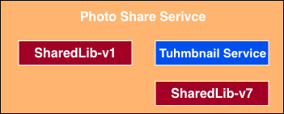
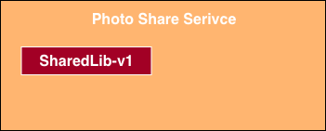
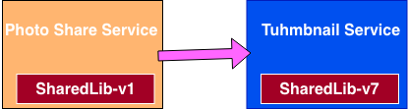
Reasons to split monolithic app to microservices
Conflicting Dependencies

Slide 12
Microservices architecture benefits myths
Microservices offer small, easy-to-understand/manage code bases
A monolith can use OOP & libraries
Library changes cause build failures (not runtime)
Failing service doesn’t impact other services
Many services require dependencies to be fully functional
Hard to write/test code that gracefully recovers when dependency fails
We run multiple service instances so there is no “failure”
A monolith is up/down completely

Slide 13
Microservices architecture benefits myths
Many promoted benefits are really about forces discipline
A microservices architecture is not required

Slide 14
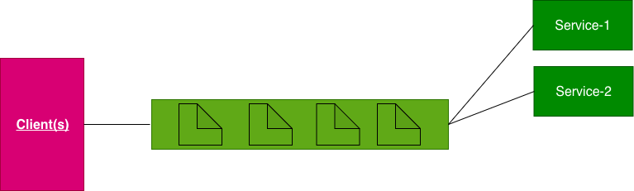
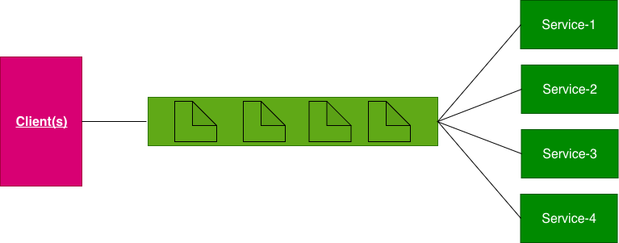
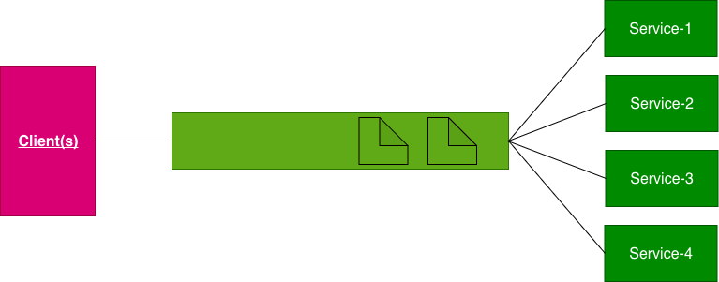


Auto Scaling
Periodically check queue length/resource usage
If growing -> scale up; if shrinking -> scale down

Slide 15
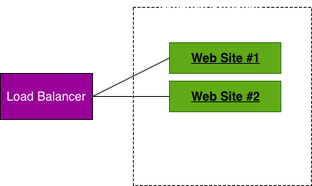
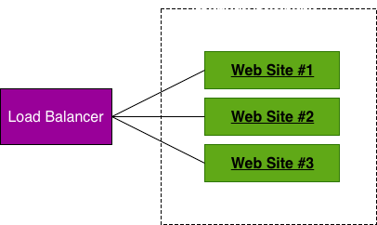
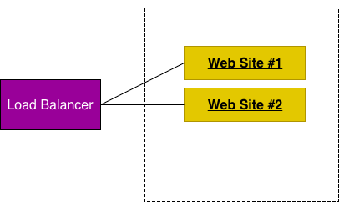
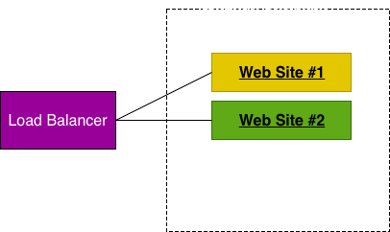
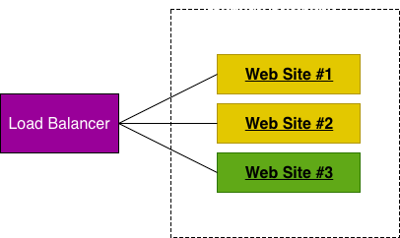
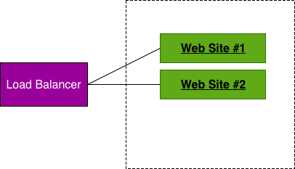
Auto Scaling
Periodically check queue length/resource usage
If growing -> scale up; if shrinking -> scale down

Slide 16
Auto Scaling
Scheduled (day/night, weekdays/weekend/holidays)
You’ re predicting load based on what you expect
Potentially dangerous as actual load may be different than predicted

Slide 17
12-factor services
Single root repos; don’t share code with another service
Deploy dependent libs with service
No config in code; read from environment variables
Handle unresponsive service dependencies robustly
Strictly separate build, release & run steps
Builds a version of the code repo & gathers dependencies
Combines build with config -> Release Id (immutable)
Runs service in execution environment

Slide 18
12-factor services
Service is stateless processes & shares nothing
Service listens on ports; avoid (web) hosts
Use processes for isolation; multiple for concurrency
Processes can crash/be killed quickly & start fast
Keep dev, staging & prod environments similar
Log to stdout (dev=console; prod=file & archive it)
Deploy & run admin tasks (scripts) as processes

Slide 19
The 12 factors are all about…
Services should be simple to build, test & deploy
Services should be lightweight
Few dependencies, run fast & use less RAM
Services should give reproducible results on developer PC as well as test, staging & production clouds

Slide 20
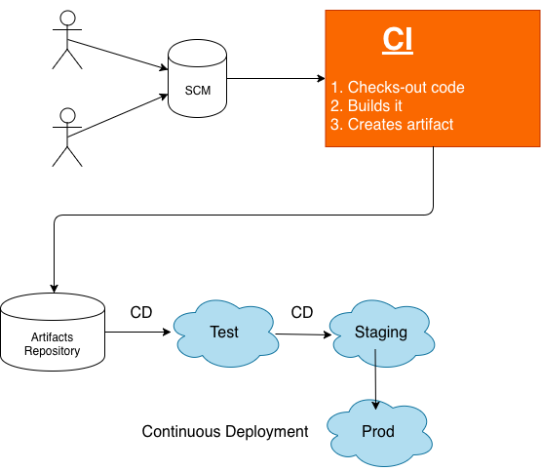
CI: Continues Integration CD: Continues Delivery & Deployment

Slide 21
CI: Continues Integration CD: Continues Delivery & Deployment
Modern DevOps is all about automation; any failures are sent back to developers & stops further progress

Slide 22
API Versioning
Is an illusion; you must always be backward compatible
You’re really always adding new APIs & stating that latest version is preferred
The required “version” indicated which API to call
http://api.bobo.com/v1/products/users
http://api.bobo.com/products/users?api-version=1
http://api.bobo.com/products/users?api-version=2016-12-07
Add new API when changing manadatory parameters, payload format, error codes (fault contract), or behavior

